Slide 1
ANTI-OPPRESSIVE MANAGEMEnT (AOP):
Past, Present and Future
Notes:
https://www.artnet.com/auctions/artists/shepard-fairey/tyrant-boot-2

Slide 2
LAND ACKNOWLEDGEMENT
The land I am speaking on is the traditional territory of many nations including the Mississaugas of the Credit, the Anishnabeg (Ah-nish-naw-bek), the Chippewa, the Haudenosaunee (Hoodt-en-oh-show-nee) and the Wendat people. The land is now home to many diverse First Nations, Inuit and Métis peoples.
Notes:
https://malindaprudhomme.com/art.html
https://www.google.com/search?hl=EN&tbm=isch&sxsrf=ALeKk02WoB_FAJroO2DOUeTFD_yI16VXUQ%3A1604553772964&source=hp&biw=1440&bih=789&ei=LIyjX8rMOOPD_QaD1pSgBQ&q=toronto+native+woman&oq=toronto+native+woman&gs_lcp=CgNpbWcQAzoECCMQJzoICAAQsQMQgwE6AggAOgUIABCxAzoGCAAQCBAeOgQIABAYOgQIABAeUMOlAVi1vAFg1sABaABwAHgAgAFKiAHYCpIBAjIwmAEAoAEBqgELZ3dzLXdpei1pbWc&sclient=img&ved=0ahUKEwjKkqLN1OrsAhXjYd8KHQMrBVQQ4dUDCAc&uact=5#imgrc=BrAtR_ebxwIabM
https://www.toronto.ca/city-government/accessibility-human-rights/indigenous-affairs-office/land-acknowledgement/

Slide 3
Major Points: Changes over the last 30 years
Demographics in ESL
How the Canadian context has changed
Anti-Black Racism and Islamophobia
Policy, practice and theory
Theory of Change Management

Slide 4
Who are we and how did we get here?
Clientele – nationalistic to globalized
Teacher Workforce – Canadian born native speakers to international educators
Management – Managers to former instructors

Slide 5
Hate crimes
in
Canada
increased by​ 207%
Notes:
https://www.ottawamatters.com/local-news/ontario-sees-dramatic-increase-in-hate-crime-during-2017-1142305

Slide 6
Anti-Black Racism
Notes:
https://www150.statcan.gc.ca/n1/pub/85-002-x/2020001/article/00003-eng.htm

Slide 7
Islamophobia in Toronto
Notes:
https://toronto.citynews.ca/video/2020/09/13/man-killed-in-stabbing-attack-outside-rexdale-mosque/

Slide 8
Should language learning providers help students deal with racism in Canada? Yes/No

Slide 9
Limitations of Policy: Scenario #1
A group of predominantly affluent White seniors who had been playing badminton together for the better part of a decade in the Con. Ed. Program at the local school enjoyed staying late after class.
The custodian who is Black was required to set the alarm by 10:00 pm. When he asked the seniors to leave, one woman called him a racially charge anti-Black word. He responded by calling her a sexist word.
Notes:
https://www.blackmenco.com/commercial-cleaning/
https://www.alamy.com/stock-photo-senior-woman-between-70-and-80-years-old-is-keeping-badminton-rackets-176330429.html
This scenarios was a personal communication from my supervisor at the school where the incidents occurred (Reimer, 2011, personal communication)

Slide 10
When the punishment was handed down the Black custodian got a two-week, paid leave of suspension. The manager was required to speak to everyone in the evening Con. Ed. program to let everyone know it was required to leave as soon as possible after class. ​
​
The White senior received no repercussions.

Slide 11
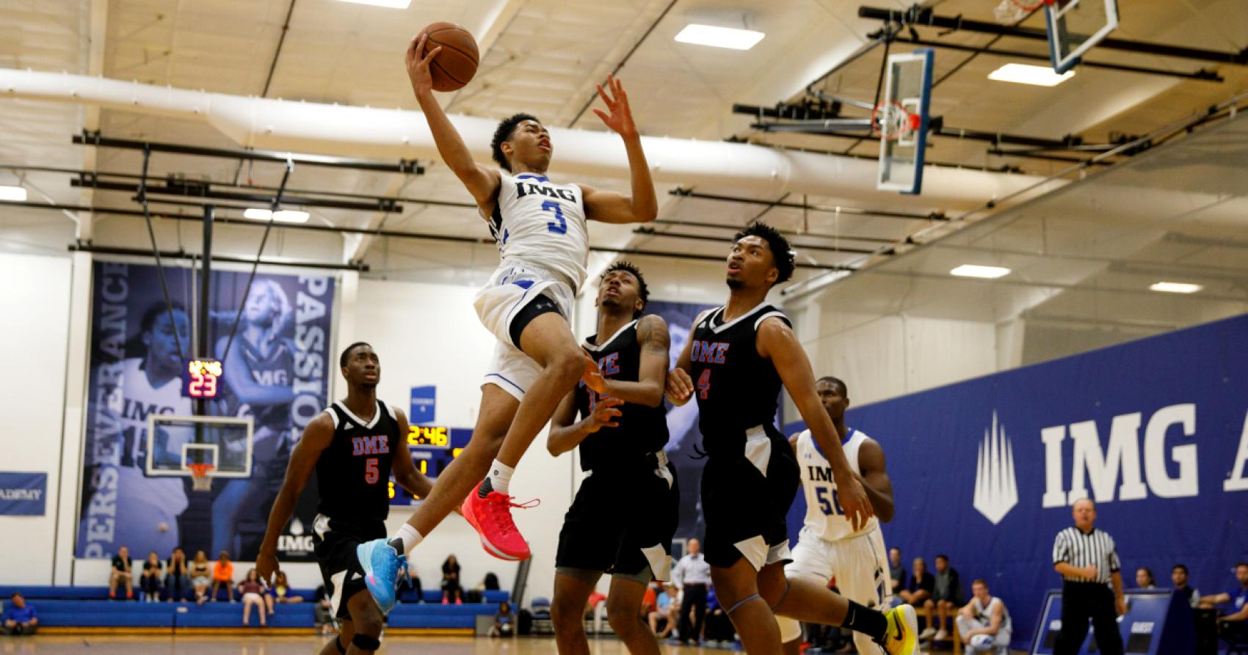
Limitations of Policy: Scenario #2
A group of boys who are Black are playing basketball after school. The custodian who is a White woman, asks the boys to leave and call them a racially charged anti-Black word.
The boys become angry and call her a sexist word.
When the punishments were handed out, the boys were suspended from school for one week. The White custodian receive no repercussions.
Notes:
https://www.gettyimages.ca/detail/photo/janitor-cleaning-hospital-room-royalty-free-image/91156591?adppopup=true
https://www.imgacademy.com/boarding-school/athletics/basketball
This scenario was based on the personal communication of (Reimer, 2011) but I switched the race of the people in the interaction.

Slide 12
Are equity policies just a paper tiger?
Notes:
https://www.pinterest.ca/pin/568086940473871590/

Slide 13
1) The White senior received no repercussions. 2) The White custodian received no punishment. 3) Policies are limited. 4) The true purpose of policies is to protect the institution, not achieve equity.
White Privilege is
reproduced through policies

Slide 14
Image in workplace culture :
CORPORATE CREATION
history, morals and values
current image
Senior management hope to keep the image of integrity
Privileges and benefits staff who are white experience
WORKPLACE CULTURE :
a psychological contract
Identity with the organization
Job security and satisfaction
Contribution in decision making
Advancement, responsibility, and recognition
Privileges and benefits staff who are not white experience exclusion
CONCLUSION – POLICIES PROTECT THE CORPORATION, NOT THE RACIALIZED INDIVIDUALS
Notes:
(Lombardi & Jefford, Organizational Methods Course, Brock University at Sheridan College, September 2009)
The image was offered by PowerPoint designs.

Slide 15
Barriers to Equity Policy Implementation Structural Racism Media Individual Acts Stereotypes Discrimination “Since anti-racist individuals did not control mass media, the media became the primary tool that would be used and is still used to convince black viewers, and everyone else, of black inferiority.” bell hooks
Triangle of Oppression
Notes:
https://acgc.ca/wp-content/uploads/2017/01/Oppression-and-Privilege-Framework.pdf

Slide 16
Management Culture and Strategy: A dying system
Racism in leadership
Learning by frontline
creates barriers for clients
Toxic work environment
Bullying group
behaviour
Social and political immaturity and shared ignorance
Commitment to traditions leads to systemic racism. Monoracial workplaces enjoy unity based on exclusion.
Notes:
(Lombardi & Jefford, Organizational Methods Course, Brock University at Sheridan College, September 2009)

Slide 17
3 Models of Education
Assimilation
Integration
Transnationalism
Notes:
http://sjwiki.org/wiki/Cultural_erasure#.WQan11KZP-Y
http://canada.lilithezine.com/Is-Multiculturalism-in-Canada-Dead.html
http://www.ftz147.com/bringing-the-world-to-you-exporting-event/

Slide 18
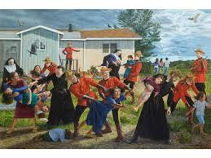
Curriculum
Global sources
Current sources
Breakdown antiquated stereotypes
Indigenized curriculum
Deconstruct Canadian exceptionalism
Notes:
https://www.tvo.org/article/challenging-canadas-history-through-art

Slide 19
School Practices
Community connections: Local groups, community events and neighborhood HUBS
Diverse professional development instructors
Acknowledgement of cultures, languages and practices through images in texts, on school walls and media
Hiring of frontline staff, custodians, teachers, leads, supervisors and managers

Slide 20
Theories to support equity:
Intersectionality - refers to interlocking forms of oppression. For example, a person can experience gender discrimination as a woman and anti-Black racism.
Transnationalism – challenges the notion that immigrants lose their ethnic identity over time. Instead, they retain the culture form their mother country.
Anti-oppressive Theory (AOP) - umbrella term for five equity seeking groups which are women, people of color, Indigenous, LGBTQ and the physically challenged

Slide 21
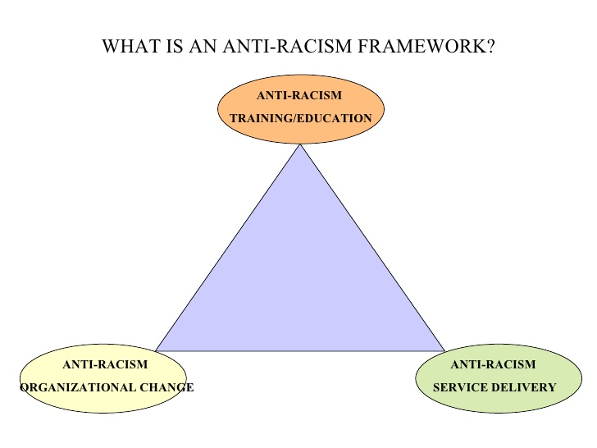
Intersectionality
When Kimberlé Crenshaw (1989) defended women who were Black against a class action suit against GM for being passed over for promotions, the judge said she could argue her case of discrimination based on gender or race but not both.
Crenshaw then noted that this argument did not acknowledge the interlocking forms of oppression that constitute barriers women of color face in systemic oppression.
In order to respond to institutional oppression, anti-racist strategies are required.
There needs to be anti-racist training, service delivery and organizational change.
Notes:
https://lannan.org/bios/kimberle-crenshaw
https://thinkingraceblog.wordpress.com/2017/04/24/were-all-just-different-how-intersectionality-is-being-colonized-by-white-people/
https://checkyoself.info/wp-content/uploads/2020/06/DemarginalizingtheIntersectionofRaceandSex.pdf
Crenshaw, K. (1989). Demarginalizing the Intersection of Race and Sex: A Black Feminist Critique of Anti-discrimination Doctrine, Feminist Theory and Anti-racist Politics. University of Chicago Legal Forum, p139.

Slide 22
Transnational Theory
MYTHS
FACTS
As immigrants reside in the new home they become less involved in their mother country.
First generations born in the host country, adopt Canadian identities.
Despite not speaking the language or living in the parents’ countries of origin, grandchildren can develop transnational identities through relationships, usually with grandparents.
Notes:
Schiller, N., Basch, L., Blanc-Szanton, C. (1992). Transnationalism: A New Analytic Framework for Understanding Migration. Annals of the New York Academy of Sciences, 645 (1), p.1-24.
Retrieved from https://d1wqtxts1xzle7.cloudfront.net/54166790/Towards_a_Definition_of_Transnationalism20170817-18865-42m8sg.pdf?1502988724=&response-content-disposition=inline%3B+filename%3DTowards_a_Definition_of_Transnationalism.pdf&Expires=1605426400&Signature=T96f0hYRpwDDrLWu2E2jW8daIIZSpFQa0eC2X~IeL3gkfyhcbd3487PAyGCu-Rwohd-ryecpXRBwtfUnczaDKKx2NVC2we6IbQq0iy63a8jfQH~mGxoUexBzCi2VZgGZdizdFGBuXGNpabhhoglKCiTS0sRkP3FlEfVJnwWXpaAgZHmkoml7lTLGAnClqsucpPwaeGsZ0ZOAAf5gUxj97KaJQ9etSgUQ5rQkJxO2CJIV-zlBEDyM9Aw0cwqvsC5Y3qxyAFHyG6OzMOuV~44Z4u5bUk7WpxeEbIAyoKKBr-5~AnBQbpz1iBwnvEk1BmG19hCQdVH-fK0uErSVqKvYiQ__&Key-Pair-Id=APKAJLOHF5GGSLRBV4ZA

Slide 23
Community Protests in Toronto
Sri Lankan (2009)
Nigerian (2020)
Notes:
https://www.youtube.com/watch?v=Arr5Ct19MPU&t=9s
https://www.youtube.com/watch?v=yeio-lWJ4u4

Slide 24
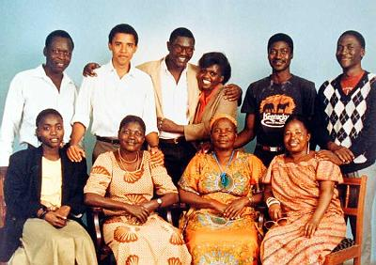
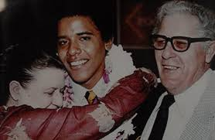
Relationships transcend time and space across continents and generations to reproduce cultural identities.
Notes:
ELLs may not leave behind the cultures from the mother country. Instead, long term connections which transcend space across international borders and time through relationship with multi-generational family members are kept throughout an immigrant’s lifetime. Remittances sent home are a key part of the immigrant experience. As well, the responsibility for caring for aging parents remains a factor in immigrants’ lives who may be well established in the host country. In this way, assimilation and integration models have failed to appreciate the full extent of ethnic ties back home. Immigrant ties to the mother country do not necessarily diminish over time and exist in the third space of kinship relationships and community ties.
Left to right images retrieved from http://www.tadias.com/wp-content/uploads/2008/01/obama-with-american-grandparents.jpg and http://africasacountry.com/2016/10/barack-obama-the-halfafrican-president/
Quote retrieved from:
https://www.un.org/en/events/culturaldiversityday/pdf/Investing_in_cultural_diversity.pdf

Slide 25
Anti-oppression Theory
Umbrella term that seeks to democratize hierarchical relationships based on oppressing and exploiting
Encompasses five equity seeking groups: gender, race, Indigenous, disabled and LGBTQ
Notes:
Kumashiro, K., Ali Baber, S., Richardson, E., Ricker‐Wilson, C. & Wong, P. (2004) Preparing Teachers for Anti‐oppressive Education: International movements, Teaching Education, 15(3), p. 257-275, DOI: 10.1080/1047621042000257199

Slide 26
Senge’s Change Management Theory
Notes:
Sica-Lieber, M. (2016). The Role of Feedback in the Learning Organization. Retrieved from
https://www.duuoo.io/post/the-role-of-feedback-in-the-learning-organization

Slide 27
A Living System Perspective: Realigning school culture
Seeds of corporate ethics and values that are norms based on frontline staff such as administrative assistants and custodial staff in schools
Long- term Success
Planting Seeds:
Creditability
Recruiting & Development
Organizational Structure
HR Measurement
Performance Management
Reap what the manager sowed – A respectful workplace that reflects equity and diversity
Budding growth and development.
Mature staff
Strategic Management
Child stage vulnerability, stability
Seek support
Reinforcement
Acceptance
Notes:
(Lombardi & Jefford, Organizational Methods Course, Brock University at Sheridan College, September 2009)

Slide 28
Dean Kerwin K. Charles Yale School of Management Broadly speaking, the requests that I’ve received for quick action, whether from direct conversation, or through the petition, may be collapsed to the following themes:
Increase the representation of Blacks among students and faculty
Address curricular concerns, such as case representation, new courses, and classroom dynamics
Provide more opportunities for consultation and input on school policy
Provide metrics, when possible
Notes:
https://som.yale.edu/news/2020/09/dean-kerwin-k-charles-announces-steps-to-respond-to-racism?utm_campaign=emba-newsletter-october2020&utm_source=newsletter&utm_medium=email
https://som.yale.edu/news/2020/09/dean-kerwin-k-charles-announces-steps-to-respond-to-racism?utm_campaign=emba-newsletter-october2020&utm_source=newsletter&utm_medium=email

Slide 29
Future Directions in Education
Hire representation – The racial gap between ESL learners, staff, instructors and managers is great
Follow up on unofficial gatekeepers – Potential Black students being turned away from the front desk and harassment from custodial staff
Indigenize curricula – residential schools closed in 1996 shortly before ESL classes expanded

Slide 30
The limits of tyrants are prescribed by the endurance of whom they oppress. Frederick Douglass (1818 – 1895)

Slide 31
References
Crenshaw, K. (1989). Demarginalizing the Intersection of Race and Sex: A Black Feminist Critique of Anti-discrimination Doctrine, Feminist Theory and Anti-racist Politics. University of Chicago Legal Forum, 1(8), p139. Retrieved from https://chicagounbound.uchicago.edu/cgi/viewcontent.cgi?article=1052&context=uclf
Kumashiro, K., Ali Baber, S., Richardson, E., Ricker‐Wilson, C. & Wong, P. (2004) Preparing Teachers for Anti‐oppressive Education: International movements, Teaching Education, 15(3), p. 257-275, DOI: 10.1080/1047621042000257199
Rowsell, J., Sztainbok, V. & Blaney, J. (2008). Losing Strangeness: Using Culture to Mediate ESL Teaching Language, Culture and Curriculum, 20(2), p, 140-154. https://doi.org/10.2167/lcc331.0

Slide 32
Schiller, N., Basch, L., Blanc-Szanton, C. (1992). Transnationalism: A New Analytic Framework for Understanding Migration. Annals of the New York Academy of Sciences, 645 (1), p.1-24. Retrieved from https://www.academia.edu/457018/Transnationalism_A_New_Analytic_Framework_for_Understanding_Migration_and_A_Global_Perspective_on_Transnational_Migration_Theorizing_Migration_Without_Methodological_Nationalism_
Senge, P. (1990). The Fifth Discipline: The art and practice of the learning organization.
New York: Currency Doubleday. Retrieved from http://kmcenter.rid.go.th/kmc08/km_59/manual_59/Book6/The-Fifth-Discipline.pdf

